Slide 1
Anatomy of female reproductive system

Slide 2
Parts female reproductive system
Two main parts
Ovaries : glandular part (production hormones)
Endocrine gland
Oviduct, uterus, cervix and vagina : tubular part

Slide 3
Parts female reproductive system
Ovaries
Shape :
Cows: oval , almond
Ewes and goat: oval
Mare : kidney shape, bean shape
Pig : grape like shape
The shape of ovary is depend on:
Type of animal, stage of estrus cycle, age, species, times of pregnancy, nutrition

Slide 4
Parts female reproductive system
Ovaries
Generally the size of ovaries in cows
1.5-5 cm length
1.3-3.2 cm width
0.6-2 cm thickness
in mare 10 cm
In ewes 2 cm
In pig 3-5 cm

Slide 5
Parts female reproductive system
Location of Ovaries
On the lateral surface and in front of the pelvic entrance
Attached to the lateral abdominal wall by the cranial part of the broad ligament of the uterus – mesovarium.

Slide 6
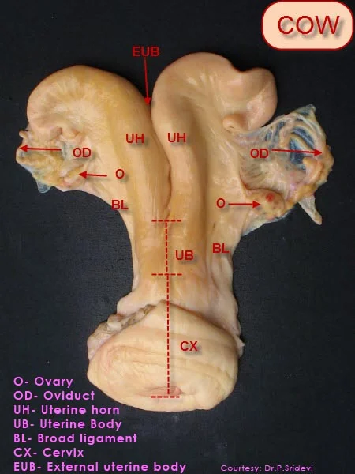
is attached to the lateral abdominal wall by the cranial part of the broad ligament of the uterus – mesovarium.

Slide 7
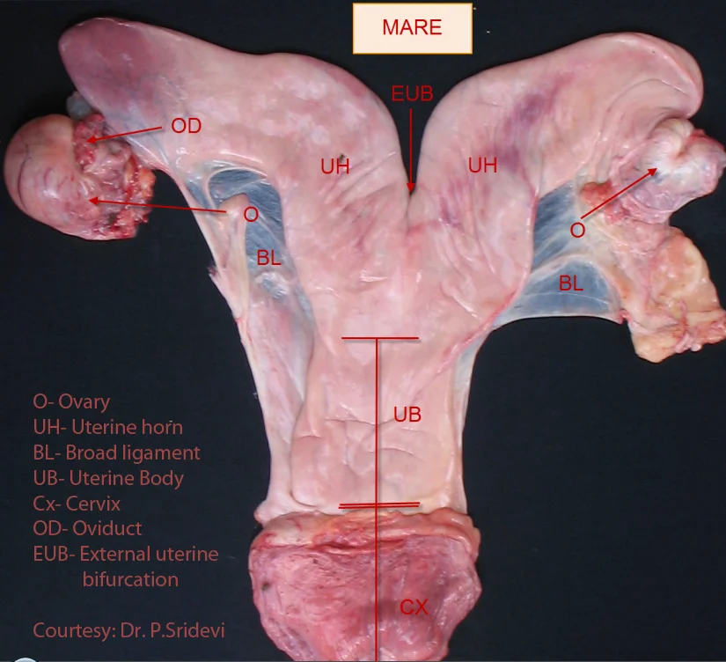
Ovary is Bean shaped and much larger, 7 to 8 cm long, 3 to 4 cm thick, weighs 70 to 80 gm in mare. Situated in the sublumbar region under the 4th or 5th lumbar vertebra.

Slide 8
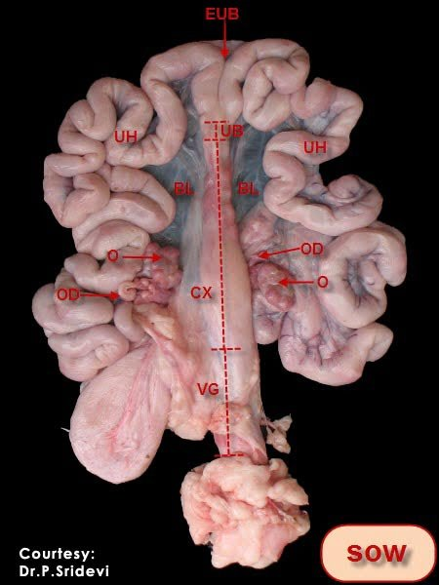
Extended inside the abdominal cavity beside pelvic brim

Slide 9
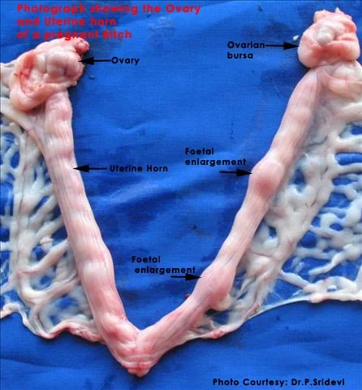
The two layers of the ovarian bursa continue to the cornu of the uterus consisting mesosalphinx and the ovarian ligament. The bursa has a slit-like opening ventrally.

Slide 10
Parts female reproductive system
Blood supply
Ovarian arteries
Utero-ovarian artery

Slide 11
Parts female reproductive system
Histology
The ovaries surrounded by Stroma (connective tissue and blood supply) except the site of Hilus (the entrance of innervation and blood supply)
The ovaries consist of two parts
Cortex
Medulla

Slide 12
Parts female reproductive system
Cortex
Primordial follicles
Primary follicles
Secondary follicles
Mature follicles
Graafian follicles
Corpus luteum
Atretic corpus luteum
Corpus albicans
Medulla
Interstitial cells, blood supply and nerves

Slide 13
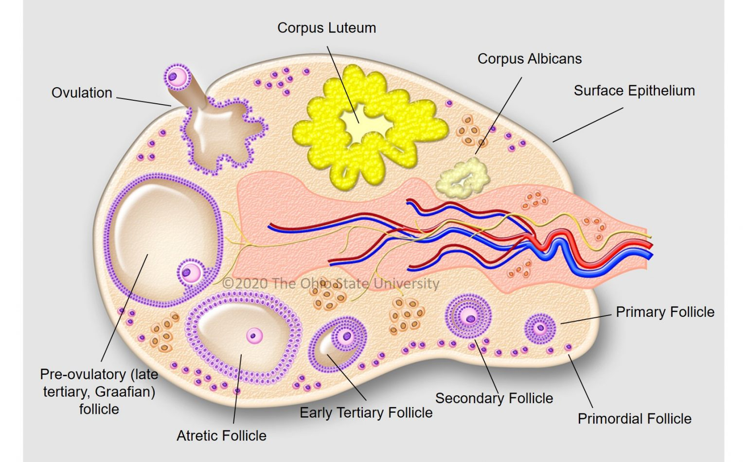

Slide 14
Parts of female reproductive system
Functions of ovaries
Releasing oocytes
Hormonal production
Estrogen from follicles
Progesterone from corpus luteum
Androgen from interstitial cells
Relaxin from corpus luteum

Slide 15
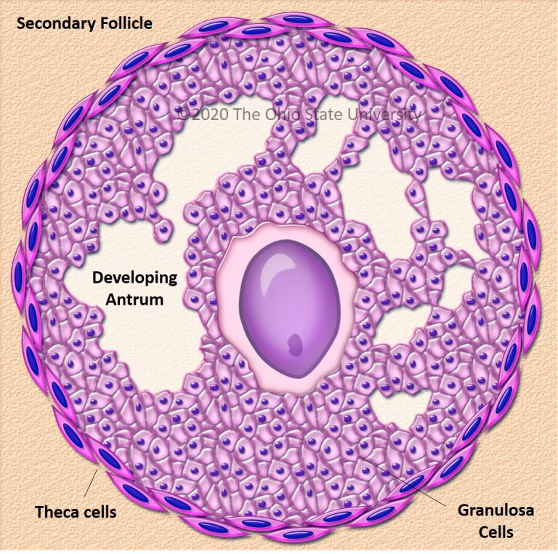

Slide 16
Oviduct or fallopian tube
15-30 cm in length (species)

Slide 17
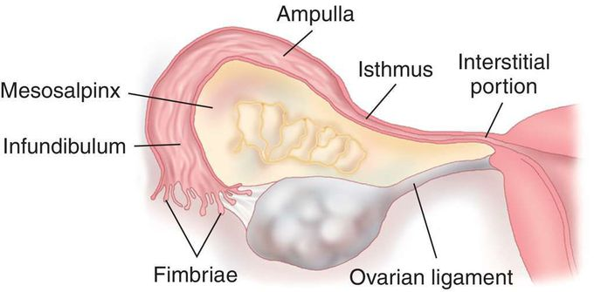

Slide 18
Parts oviduct
Infundibulum : equipped with fimbria: Picking up eggs
Ampulla : site of fertilization
Isthmus : site of developing of embryo (5 days) before entrance the uterus
Utero-tubular junction (sphincter)

Slide 19
Histology of oviduct
Epithelium (columnar cells)
Ciliated (toward uterus) stimulated with hormones
Non ciliated (glandular) stimulated with hormones
Muscular layer: The cells have ability for contraction
Serosa

Slide 20
Function of oviduct
Transfer oocytes from ovary to oviduct and inside oviduct
Transfer sperms
Two direction (sperm and oocytes)
Fertilization (the site of connection between ampulla and isthmus)
Division and developing the primary embryos (4-5days)
Capacitation of sperms
Utero-tubal junction (control the sperms movement and transfer the embryo)

Slide 21
Uterus
Body and two horns
Situated in pelvic cavity (changing according number of parturition)
Septum separate two horns (bifurcation)
Attached to the pelvic and abdominal wall by broad ligament
The shape of the uterus differ according species
Cows, ewes and goat: bi-pattitus (ram horns)
Mare : T shape (suspended under lumber region)
pig : intestinal shale (inside abdominal region)
Dog and cat: Y shape (toward kidney)

Slide 22
Histology
Endometrium (pseudo stratified epithelium )
Caruncles (site of connection with placenta)
zona spongiosa (supporting)
Zona compacta (uterine glands and blood supply)
Zona basalis (supporting)
Myomaterium
Internal layer (dense and circular )
External layer (light and longitudinal )
Blood supply and nerve and lymph
Changing occur in according hormones and status
Serosa

Slide 23
Function
Sperm capacitation
Embryo implantation
Embryo nutrition (uterine gland ) through uterine milk
Fetus incubation
Sperm transportation
Parturition
Hormonal production ( prostaglandins )
Uterus movement
Hormonal dependent (estrogen and progesterone)

Slide 24
Cervix
Sphincter between uterus and vagina
Controlling and protect the uterus from intruders
Consist from elastic fiber and muscles : tends for distension
Take 5-7 cm
In Ruminant : cylindrical shape and cartilage consist from 3-5 cartilage rings (tight closed )
In mare : longitudinal folds ( less tightly closed )
In pig : spiral ring (corkscrew shape)
In dogs : rounded (mushroom shape)

Slide 25
Cervix
Consist from 2 types of cells
Ciliated cells (transfer sperms) (estrogen)
Non ciliated cells (glandular)
Produce mucous for closing the cervix during pregnancy (progesterone)
Sperm capacitation

Slide 26
Functions of Cervix
Prevent the entrance of foreign bodies
During dilatation permit for sperm entrance
Sperm capacitation and storage for sperms
Sperm transfer
Closed during pregnancy (protect the environment of uterus)

Slide 27
Vagina
Consist from
Epithelium
Muscular
Serosa
Organ of meting
First storage for sperms
Take 25-30 cm

Slide 28
Internal genitalia : ?????
External genitalia
Vestibules
Labia
Majora
Minora
Clitoris

Slide 29
Development of female reproductive system

Slide 30
Formation of female reproductive system
After fertilization the division continue to form early embryo (embryonic vesicles) in day 35-40
In day 35, the embryo has 2 ducts
Wolffian duct which develop into male reproductive system
Mullerian duct which develop into female reproductive system

Slide 31
Genetic feature (XX or XY) play important role for determine which duct will develop while the other will atrophy
Genetic feature responsible to form primary testes or primary ovary
If the gonads are testes, they will secret testosterone and anti mullerian hormone that lead to develop Wolffian duct and regressing the mullerian duct
If the gonads are ovaries, mullerian duct will develop and regressing the Wolffian duct

Slide 32
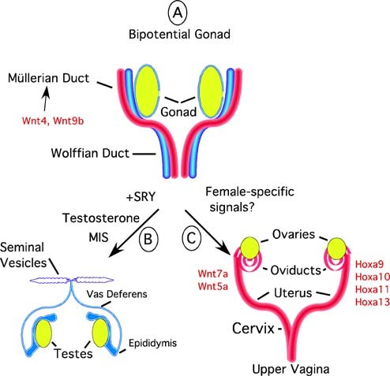

Slide 33
The formation of oocytes start from embryonic stage
During embryonic stage:
The primary ovary form from genital ridges (35-40) from pregnancy
Yolk sac suffer from extension (from hind gut of the embryo)
The germs cells migrate from this extension to the primary ovary
Migrated germ cells stay in the cortex of the primary ovary
All these germ cells suffer from proliferation (Mitotic division) and differentiation to form primordial oocytes (2N)

Slide 34
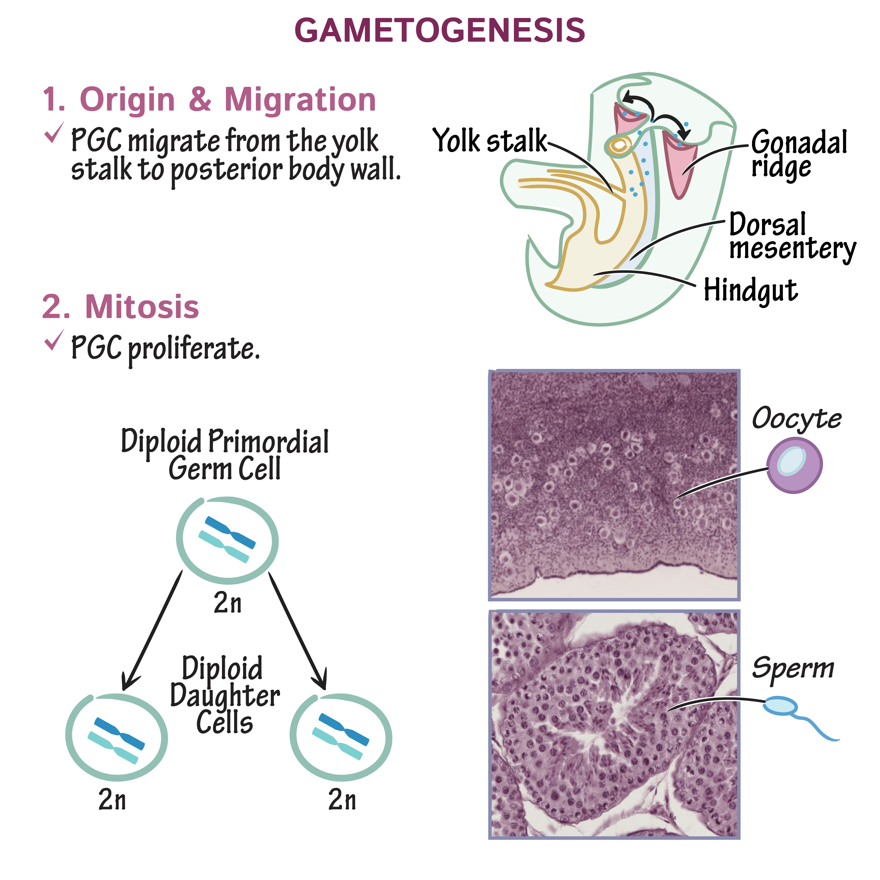

Slide 35
Before birth
this proliferation will be stop , so a fixed number of oocytes (primary oocytes) inside primary follicles (one layer of granulosa cell)
the primary oocytes enter to first meiotic division to divide the number of chromosomes in to half
Directly before birth the first meiotic division stop in prophase 1
So the fetus after birth has primary oocytes in prophase 1 with total number of chromosomes (2N) inside the primary follicle

Slide 36
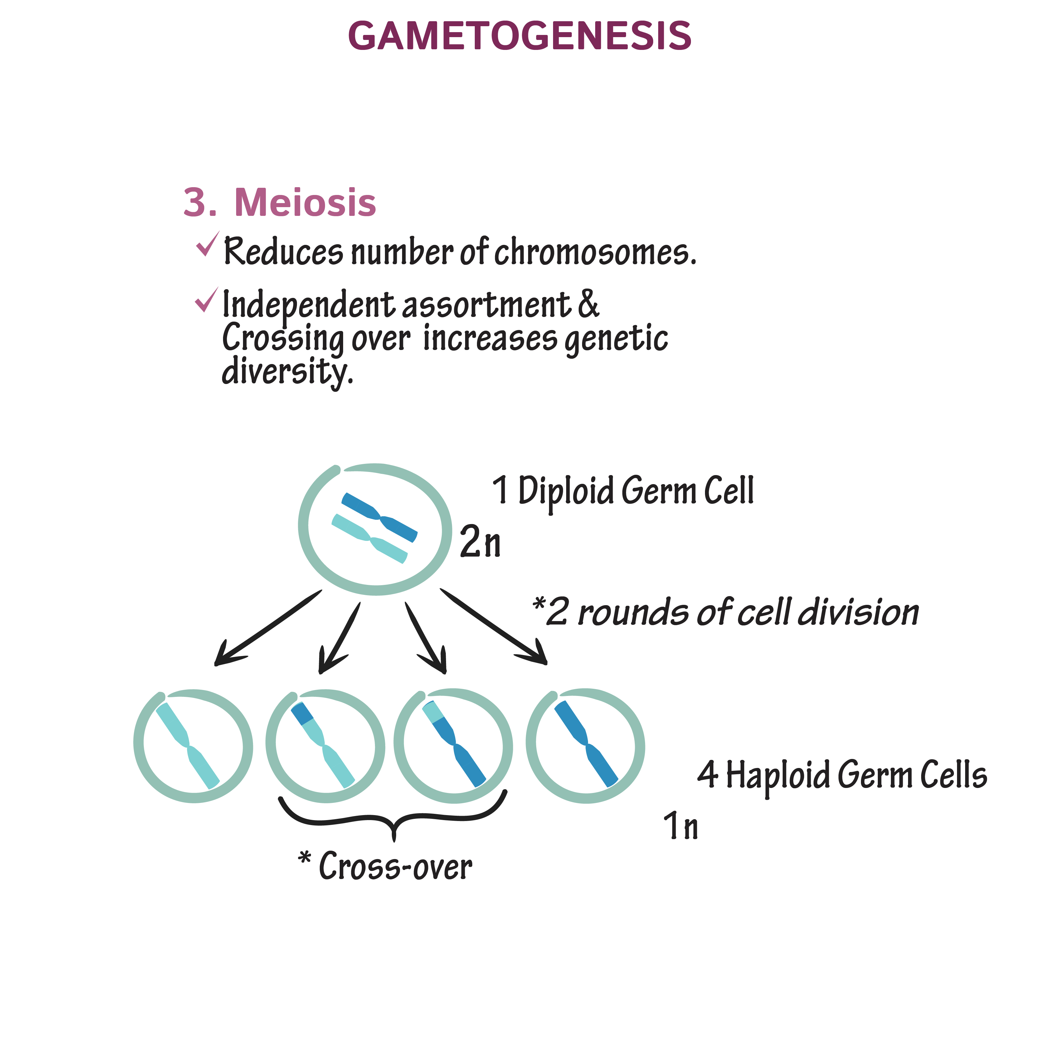

Slide 37
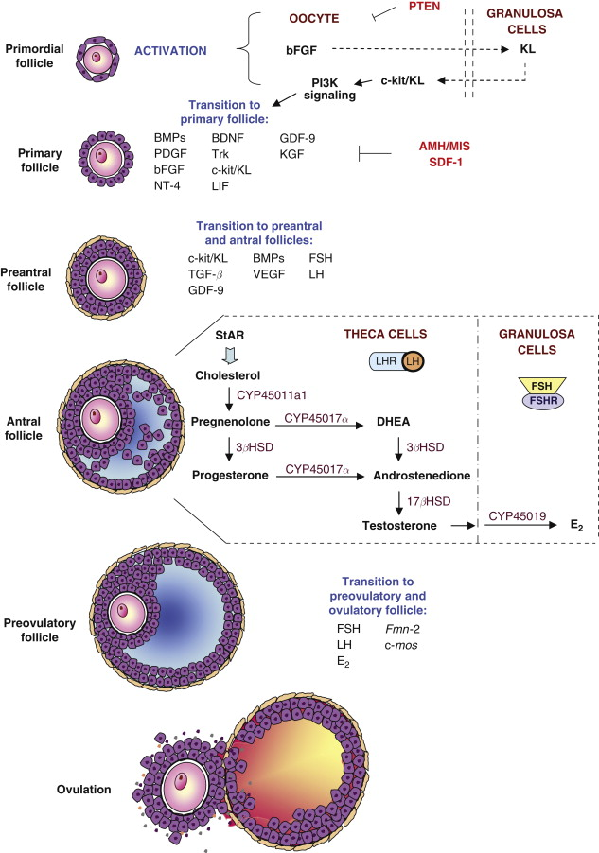
After birth:
The primary oocytes suffer from growth and maturation till puberty (primary oocytes (2N) inside primary follicle)

Slide 38
After puberty:
The FSH and LH will start to act on ovaries which lead to:
1- growth and maturation (oocytes and follicle) under the effect of FSH
2- formation of zona pellucida in oocytes
3- growth for primary follicle to form secondary follicle (two or more layers of granulosa cells)
4- formation of antrum (fill with follicular fluid)
5- formation of theca cells in secondary follicle (so the estrogen will be increased

Slide 39
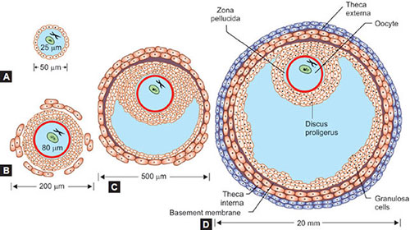

Slide 40
Before ovulation in cows, sheep and goat and after ovulation in mare:
1- the estrogen lead to increasing the LH hormone
2- the LH lead to resumption of first meiosis from prophase 1
3- the first meiotic division will be completed to form secondary oocytes which has half number of chromosomes (1N) as well as first polar body (between vitelline membrane and zona pellucida)
4- The second meiotic division (meiosis II) begins immediately after completion of the first division and arrested again at metaphase II

Slide 41
During fertilization:
1- the penetration of oocytes by sperm stimulate the resumption of second meiosis from metaphase II
2- the second meiosis will be completed to form the ova as well as the second polar body
3- the union between ova and sperm will be occur

Slide 42
